Slide 1
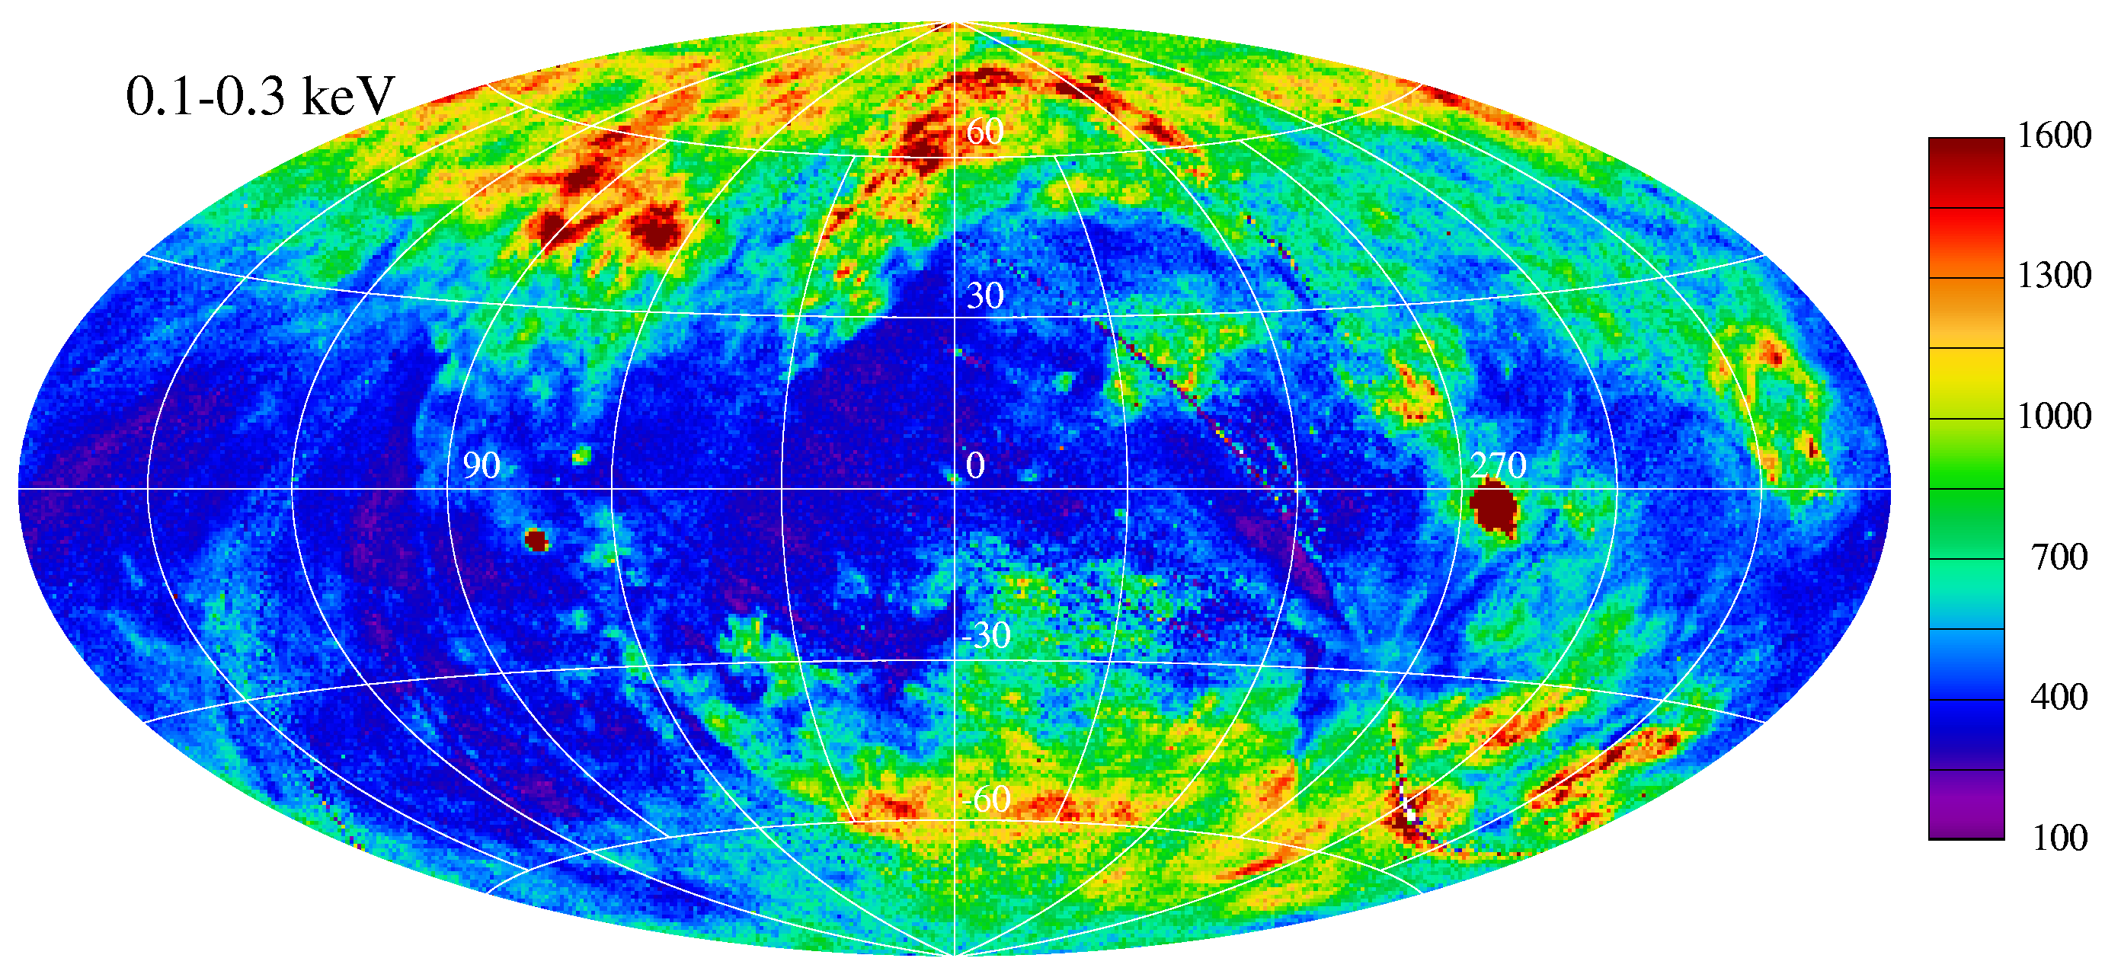
What we don’t know about hot gas in the Galaxy
Dan McCammon – University of Wisconsin

Slide 2
Current observational evidence:
is strongly against a uniform X-ray emitting hot halo, either spherical or plane-parallel.
says the halo is complicated, but otherwise hasn’t helped much
does not distinguish between wildly diverse models for the distribution of hot gas in the disk

Slide 3
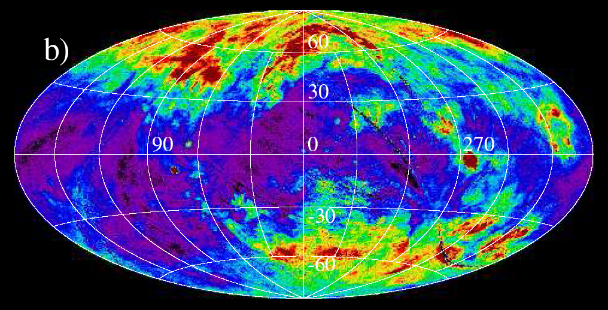
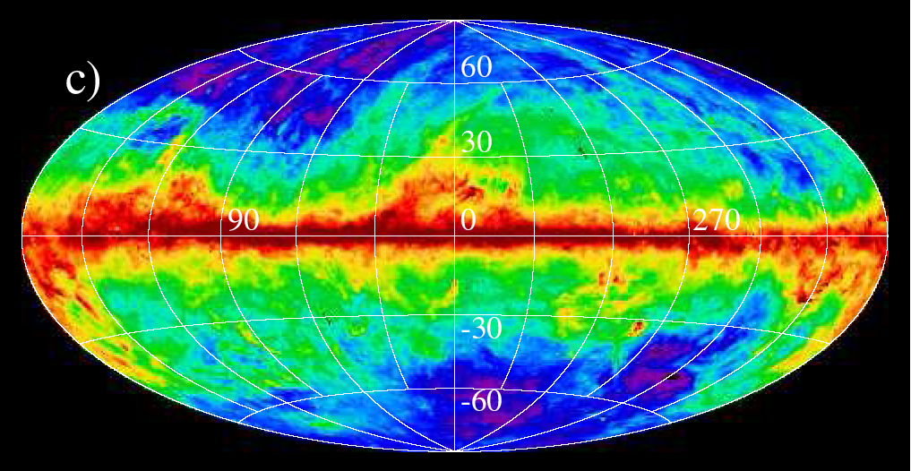
1/4-keV
100 µm
Steve Snowden

Slide 4
Absorption doesn’t work (absolute cross sections, energy dependence)
“Displacement”
mean free path ~ 30 pc

Slide 5
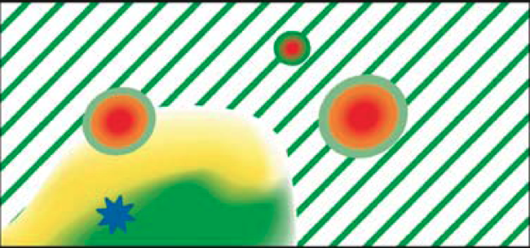
?
Bubbles of hot gas embedded in a cool ISM?

Slide 6
or
< n > = 1/cm³
Generally contiguous hot gas mixed with sheets and filaments of cool neutral gas.
(connectivity makes a big difference in reheating efficiency)

Slide 7
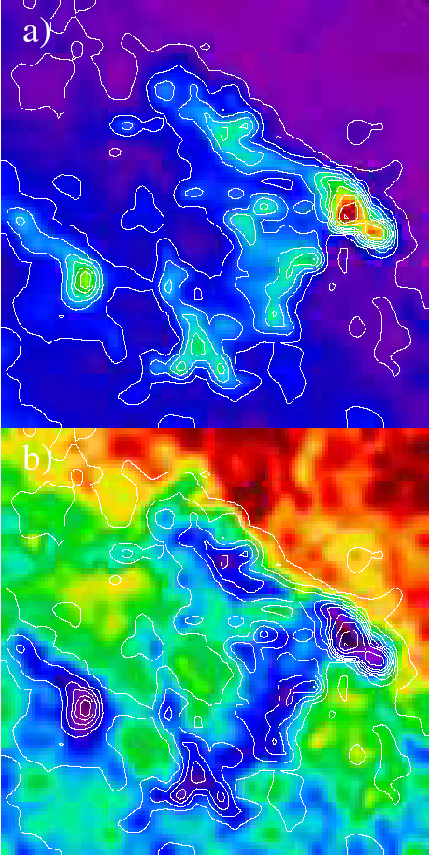
Draco cloud is at z > 300 pc
Contours = Draco Molecular Cloud density
IRAS
100µm
1/4-keV
X-ray
(IRAS Contours)
Shading = 1/4-keV X-ray brightness
Burrows & Mendenhall 1991, Snowden et al 1991

Slide 8
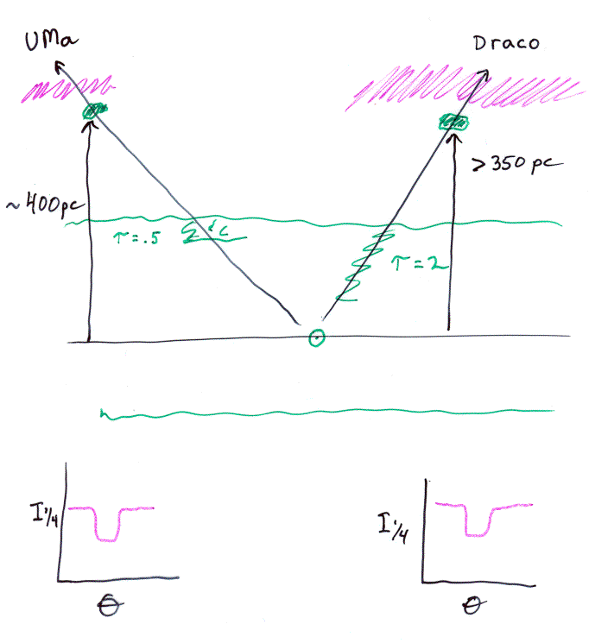
So life is more complicated. Found other examples. Bothersome feature:
Must be ~7× brighter here after absorbtion correction

Slide 9
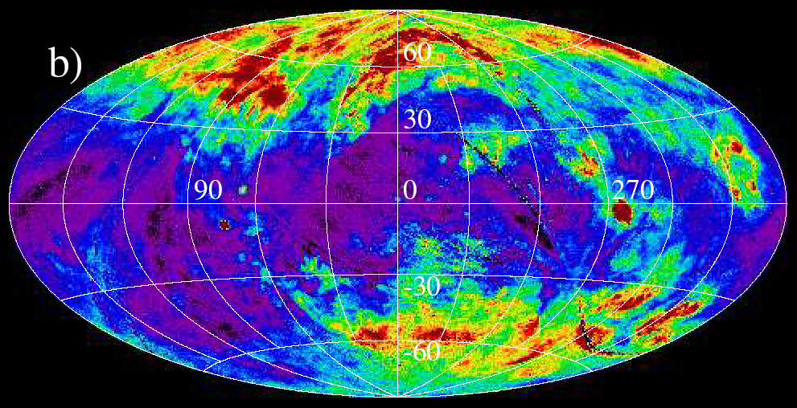
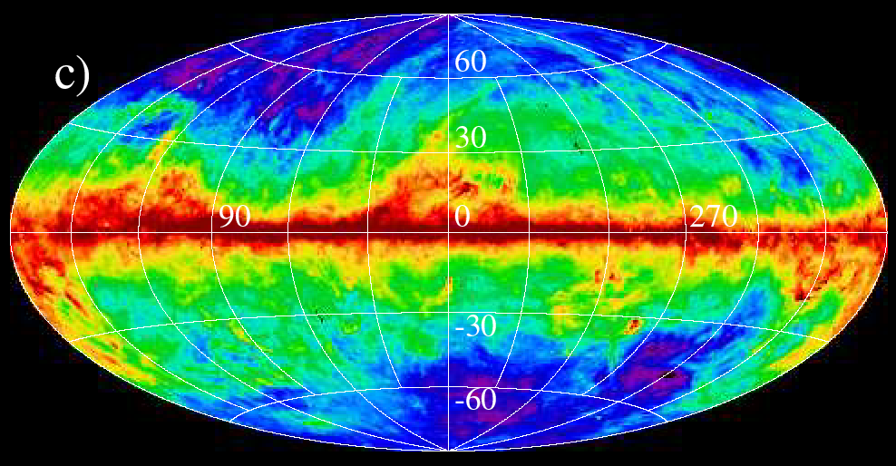
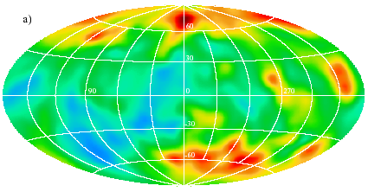
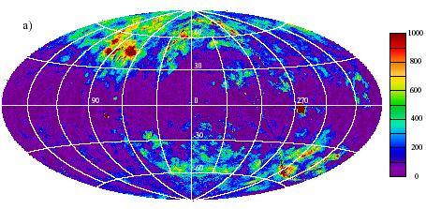
1/4 keV
IRAS
LOCAL FIT
TOTAL– LOCAL
Kunzt & Snowden 2000

Slide 10
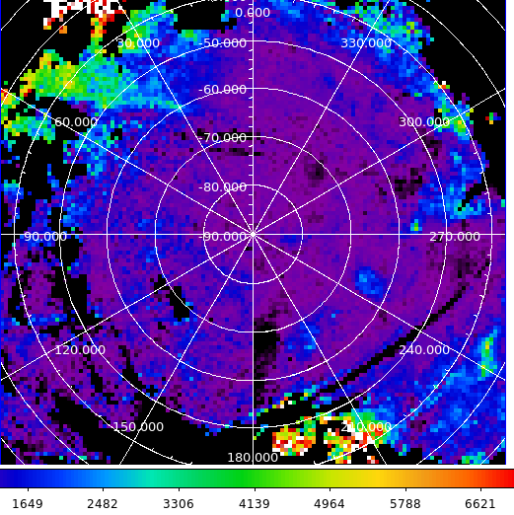
After absorption corrections:
temperature exactly the same as local bubble: ~1.0 x 10⁶ K
peak emission measures 5 x highest local bubble values = several x those of 2 x 10⁶ K “halo” gas.

Slide 11
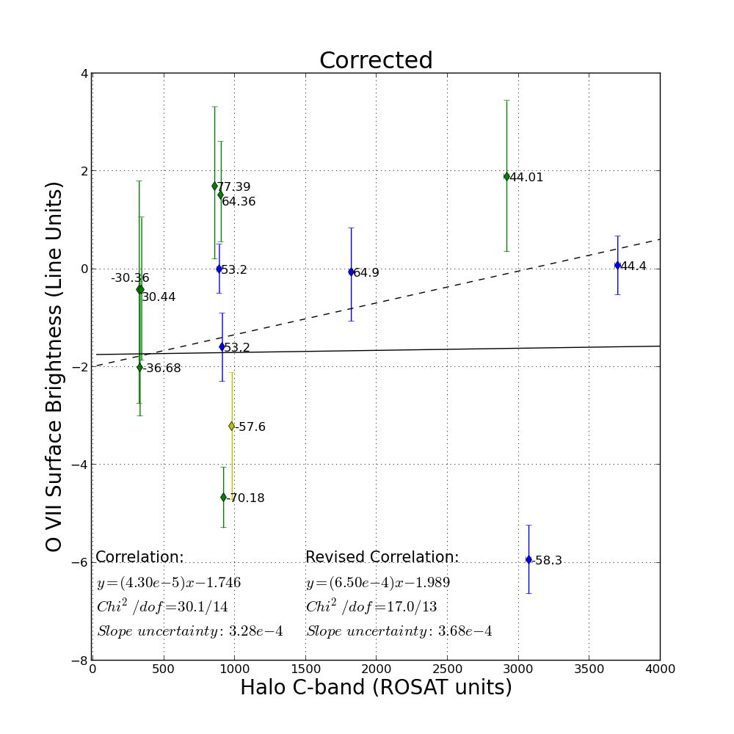

Slide 12
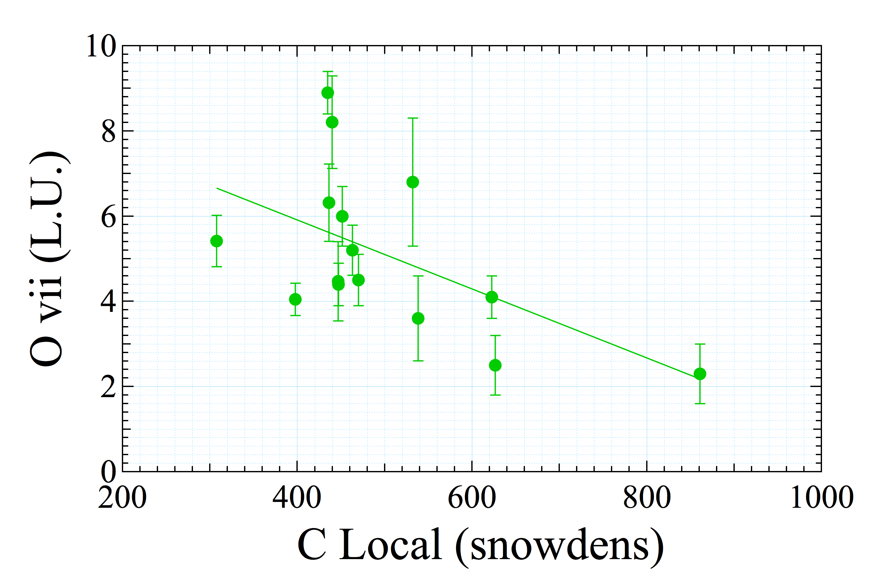

Slide 13
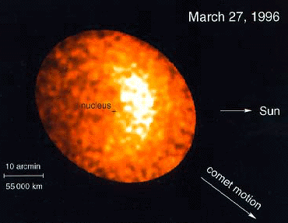
Casey Lisse et al 1996

Slide 14
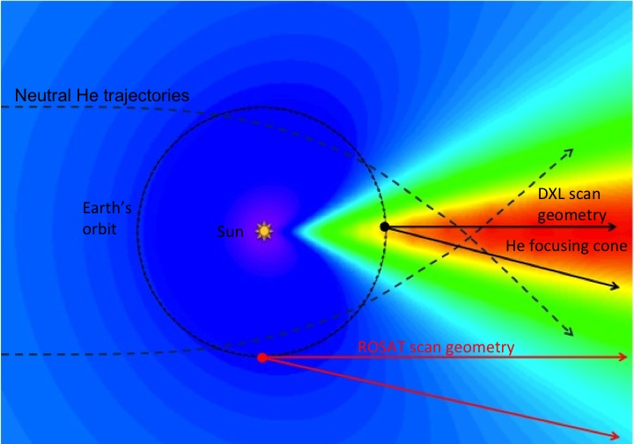
Galeazzi et al 2014

Slide 15
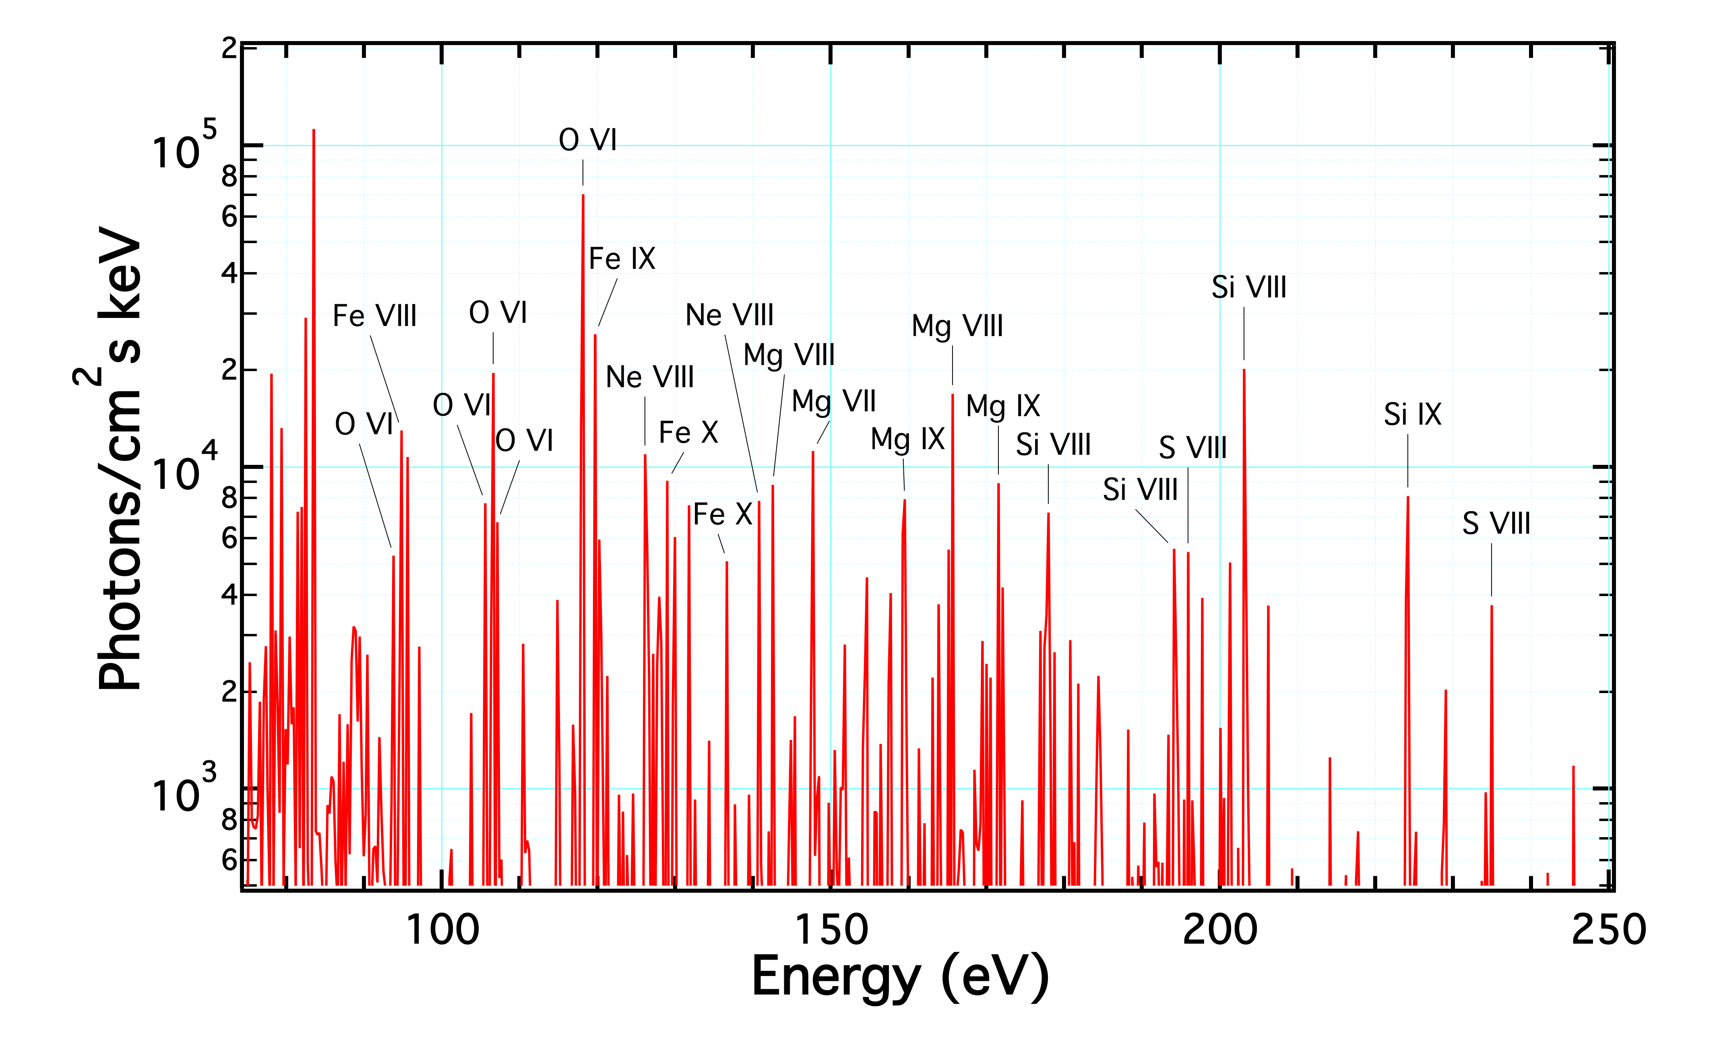
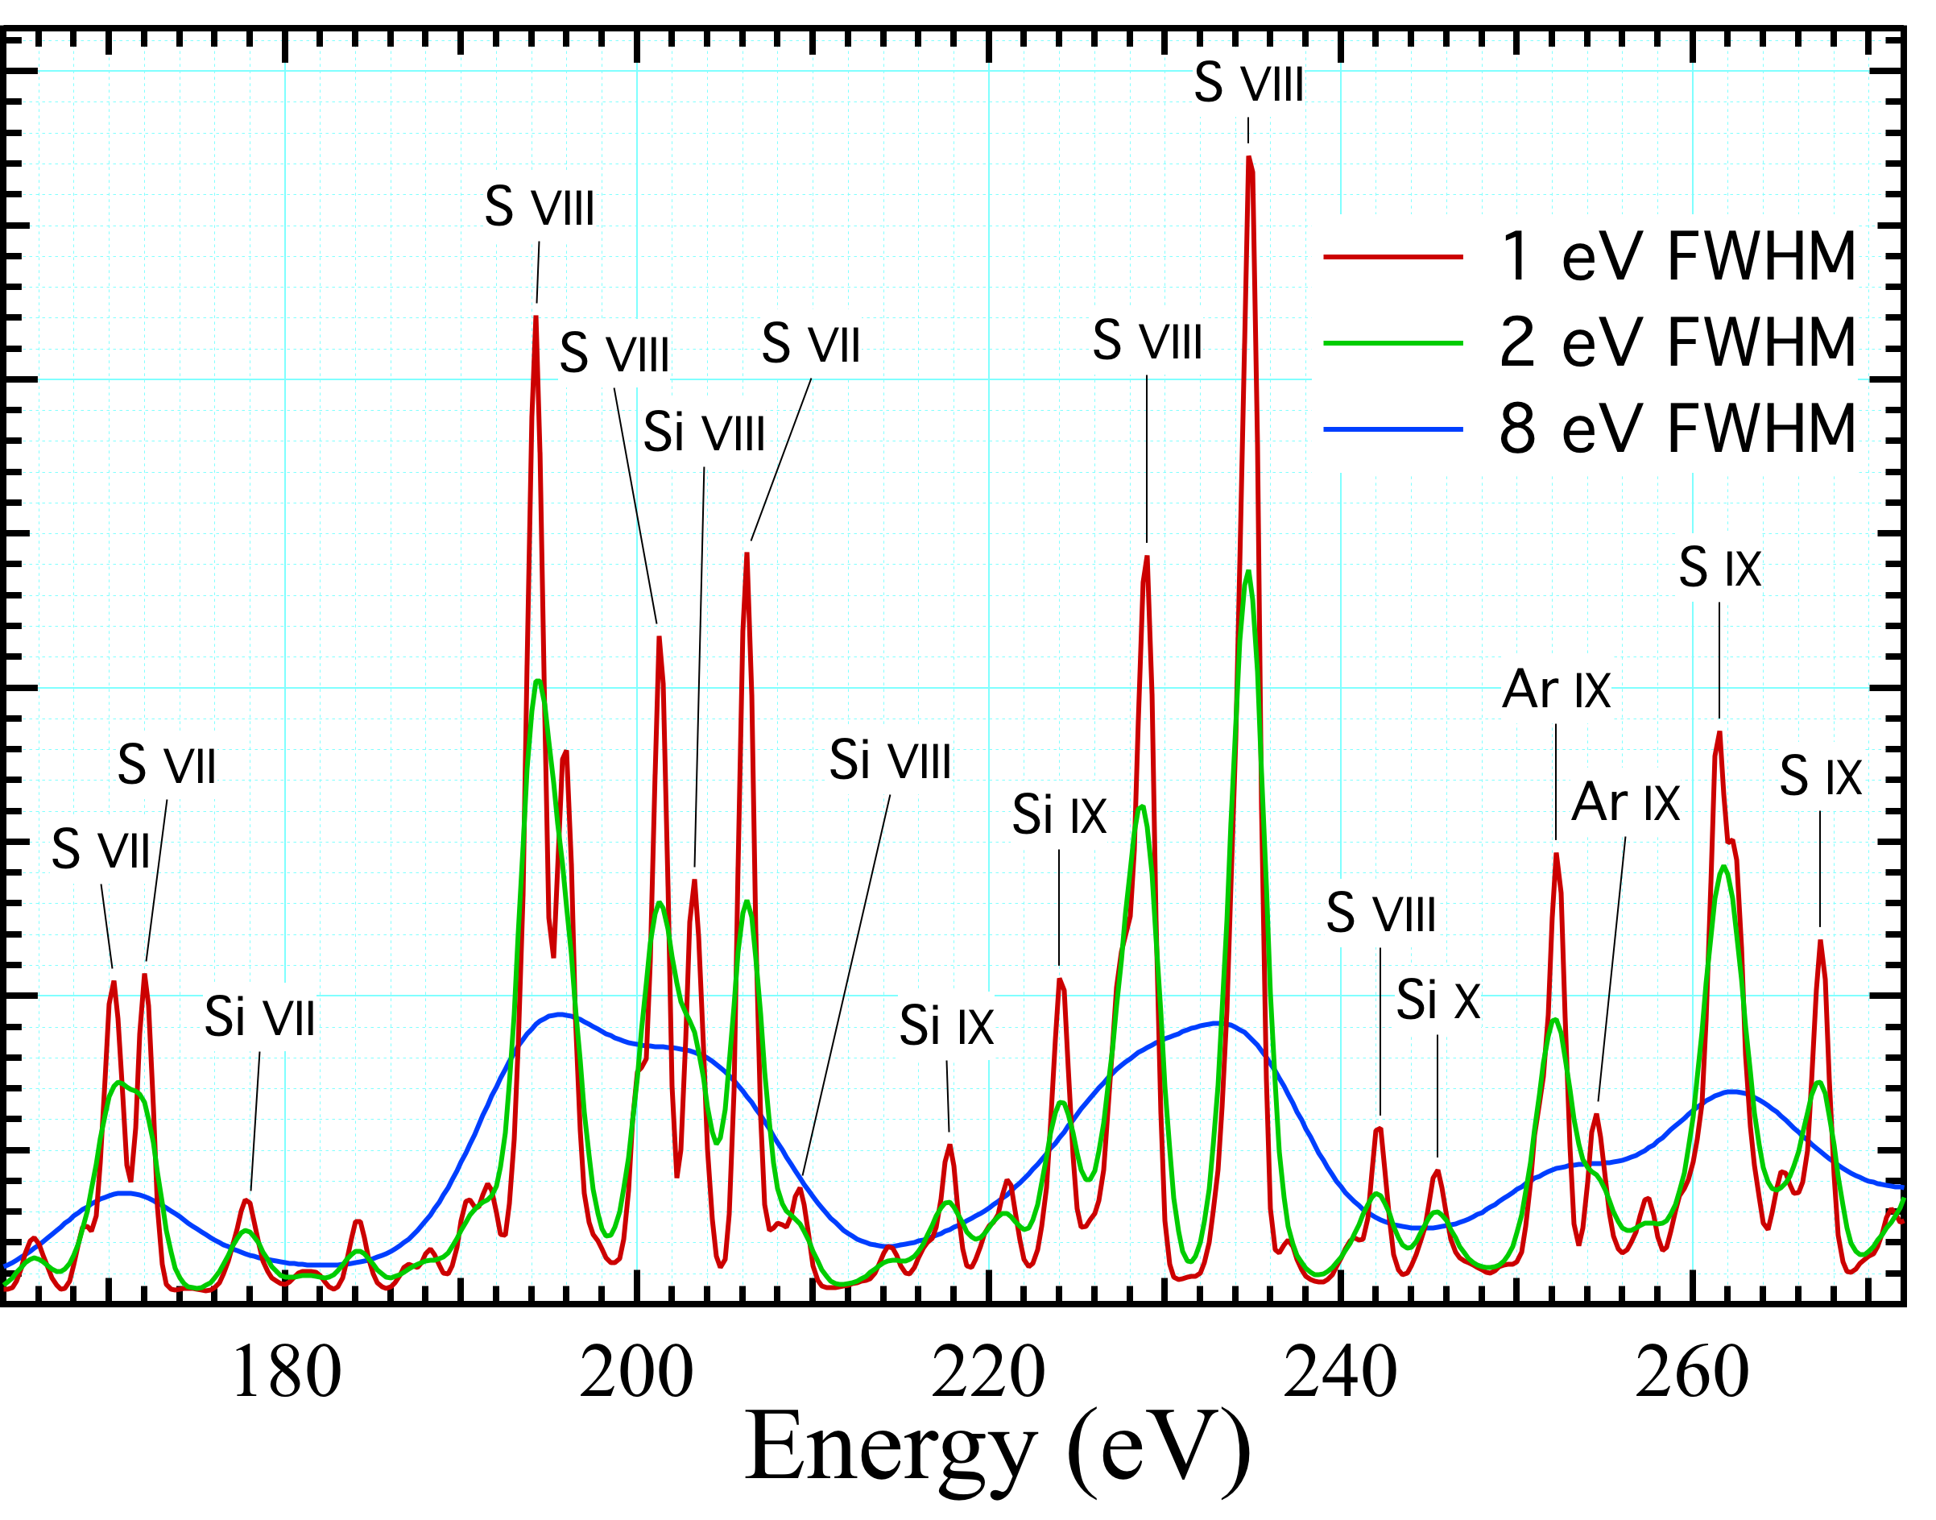
left: Emission spectrum of a solar abundance plasma in collisional ionization equilibrium at 1.0×10⁶ K. right: Simulated observations at different resolutions of a 1.0×10⁶ K plasma with diffuse depleted abundances. With solar abundances, Si and Mg ions would dominate instead of S and Ar (compare left side). It is clear that ΔE ≤ 2 eV is required to resolve individual lines

Slide 16
Source of observed ¼-keV diffuse background X-rays:
~ 30% from Solar wind charge exchange.
~ 11% from 1x10⁶ K halo gas
~ 3% from AGN
Rest presumably from Local Hot Bubble (until we think of something else).

Slide 17
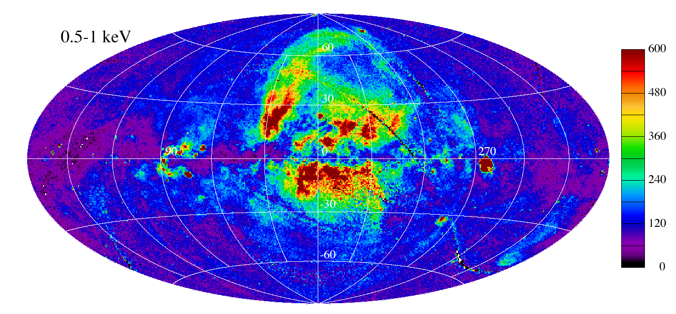
Moving on . . .
mean free path ~ 1.5 × 10²¹ H I cm^{–2} ≈700 pc
T ~ 2 –3 × 10⁶ K

Slide 18
Henley & Shelton 2014:
Analyze several halo models (Fang et al. 2013, Henley & Shelton 2013, Gupta et al. 2013, Miller & Bregman 2013)
Halo possibly convectively unstable
Halo could be isothermal, or might not be
Halo is definitely non-uniform
Possibility of two halos:
one high-metallicity non-isothermal at low z — X-ray-emitting
one isothermal low-metallicity at high z — indirect evidence
Henley & Shelton 2015:
Absorption analysis of observations on and near molecular clouds at moderate distances (200 – 400 pc) allows measurement of distant emission clearly separated from poorly known and time-variable Local Hot Bubble/SWCX foreground..
Halo emission has non-uniform distribution, different in O vii and O viii.
1/5 of measurements show very little distant emission in either line.
Two independent observations and analyses of MBM 16 show ~zero distant emission.

Slide 19
Absorption from nearby H I
What’s this ??
Looks like central ~3 kpc of Galaxy is full of 2–4 x 10⁶ K gas?
-Nicely fit by adiabatic polytrope in Galactic potential well.
Which (probably coincidentally) also provides the observed Ovii and Oviii absorption along all galactic and extragalactic sightlines within a factor of two — with most of the gas within a few kpc. Need other material to provide emission.

Slide 20
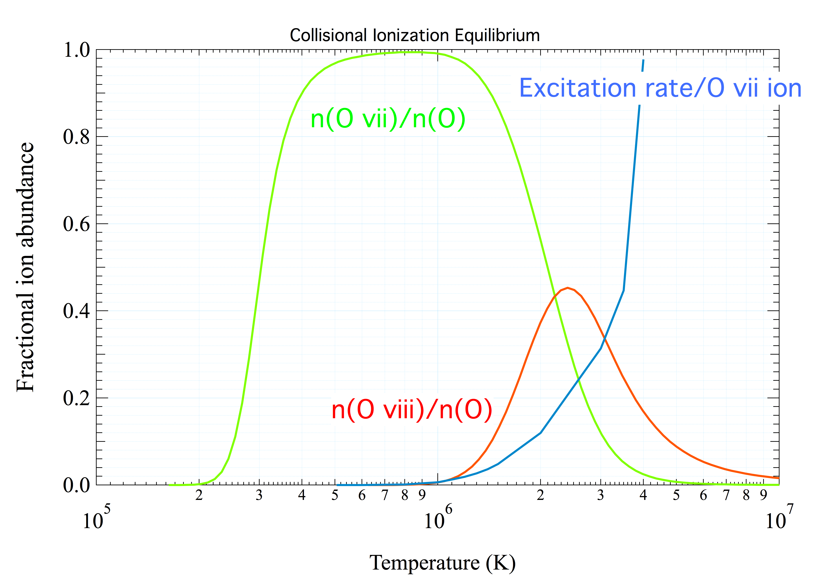
Easy to hide oxygen if only look in emission . . .

Slide 21
Halo Complexities:
~20% of on-off cloud absorption measurements show little or no distant thermal emission.
There are large emission measures (.04 cm^{–6} pc) at ≤ 1.0 × 10⁶ K somewhere in the halo.
Gould’s Belt molecular clouds (D ~ 350 pc) show little or no shadow after known AGN background is subtracted.
Ubiquitous O vi absorption observed.
There is an unknown source within the disk that over 1 kpc is ~ as bright as the halo.
Complex halo might be more compatible with galactic fountain picture?

Slide 22
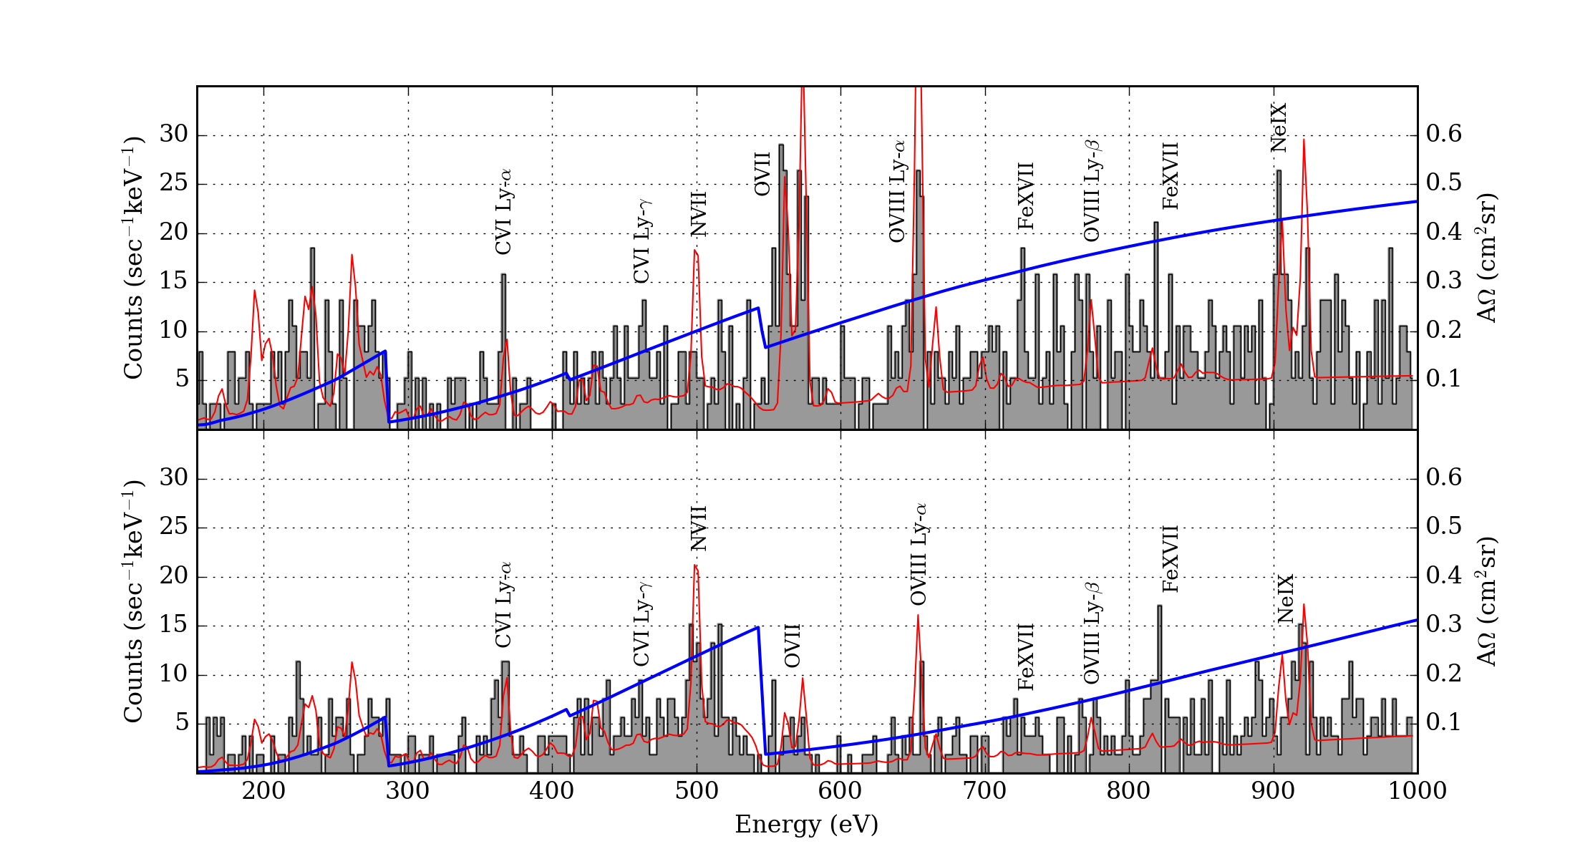
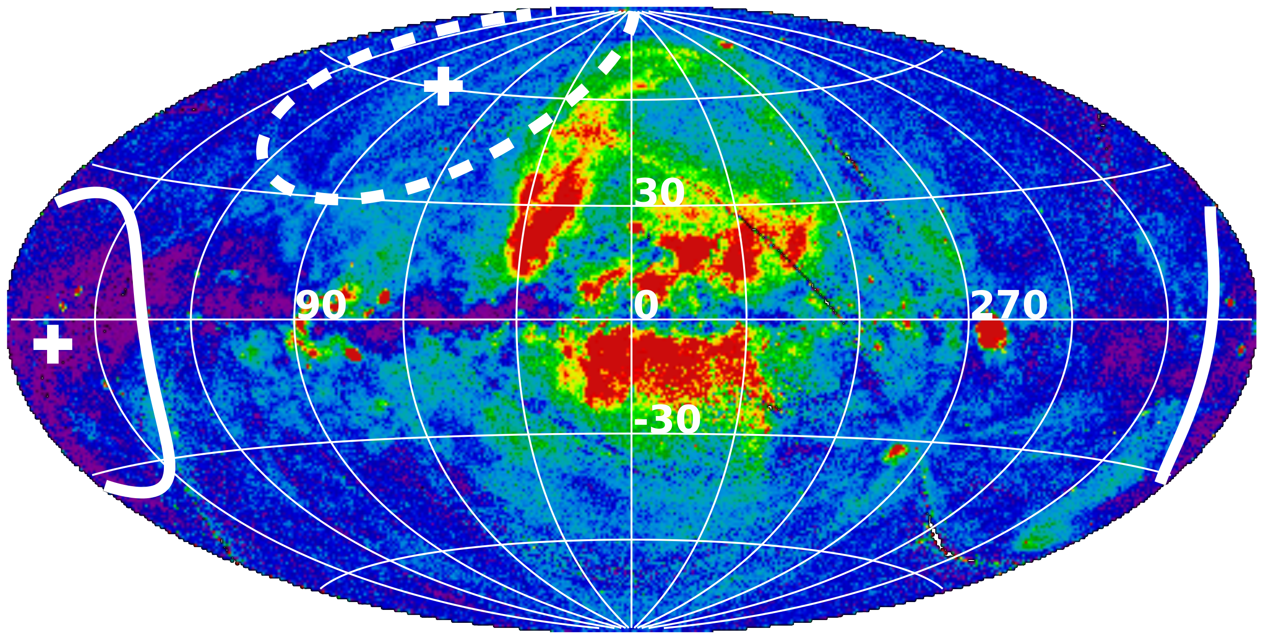
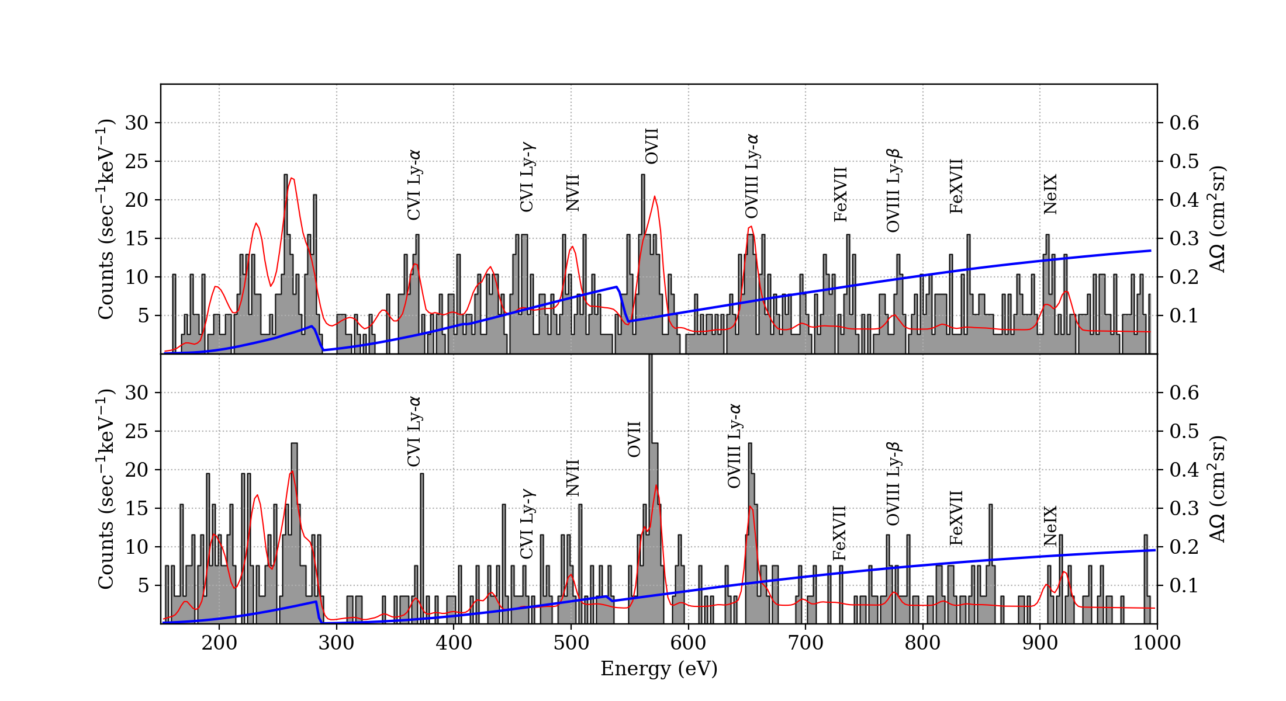
a) Flight 4
Anti-center
b) Flight 3
Hi-Latitude
c) Flight 2
d) Flight 1

Slide 23
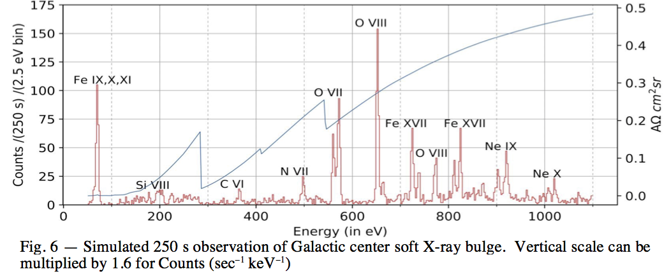

Slide 24
Mission Throughput at O VII K lines (cm² deg²)
Chandra <1
Suzaku 16
XMM (epic+MOS) 150
ROSAT 100
eROSITA 1000 (2019 March)
(4-year all-sky survey = 8 x ROSAT survey)
Good energy resolution (microcalorimeters):
XQC 3000 (x 3 minutes!) (now)
XARM/XRISM 0.09 (2021 March)
Athena 50 (2032 +)

Slide 25
Backup

Slide 26
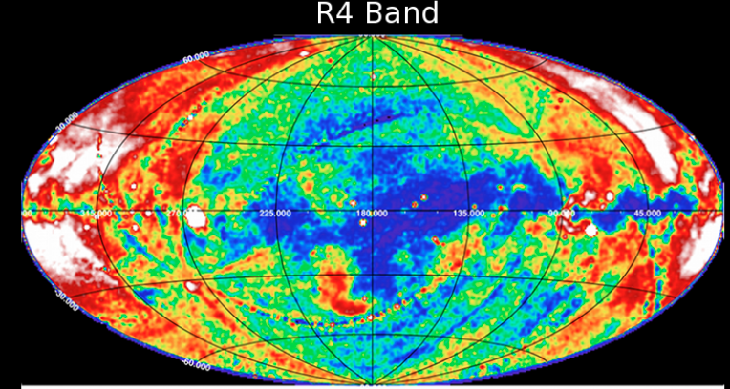
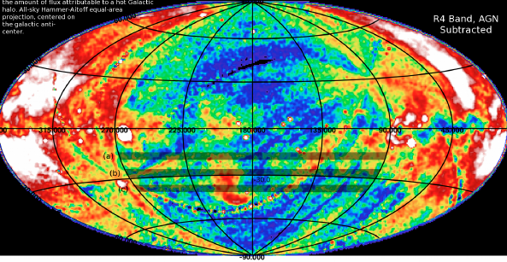
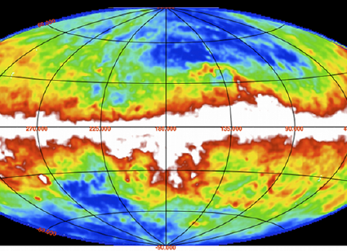
ROSAT R4 band (l=180° center)
R4 band after subtraction of absorbed AGN spectrum. Color scale is stretched further.
Most of shadow goes away when AGN contribution is subtracted. The absorbing
material near l=180° at –45°<b<–10° is largely from the Gould’s belt molecular clouds, D~400pc.
However ROSAT data quality is poor in this part of the sky and statistics are limited. (Diagonal stripes are residual contamination in survey data.) Need eROSITA!
IRAS 100 µm

Slide 27
